Slide 1
Introduction to Computers and Java
Chapter 1

Slide 2
Objectives
Overview of computer hardware and software
Introduce program design and object-oriented programming
Overview of the Java programming language

Slide 3
Section 1.1 Computer Basics: Outline
Hardware and Memory
Programs
Programming Languages and Compilers
Java Byte-Code
Class Loader

Slide 4
Hardware and Software
Computer systems consist of hardware and software.
Hardware includes the tangible parts of computer systems.
Software includes programs - sets of instructions for the computer to follow.
Familiarity with hardware basics helps us understand software.

Slide 5
Hardware and Memory
Most modern computers have similar components including
Input devices (keyboard, mouse, etc.)
Output devices (display screen, printer, etc.)
A processor (CPU)
Two kinds of memory (main memory and auxiliary memory).

Slide 6
The Processor
Also called the CPU (central processing unit) or the chip (e.g. Pentium processor)
The processor processes a program’s instructions.
It can process only very simple instructions.
The power of computing comes from speed and program intricacy.

Slide 7
Memory
Memory holds
programs
data for the computer to process
the results of intermediate processing.
Two kinds of memory
main memory
auxiliary memory

Slide 8
Main memory
Working memory used to store
The current program
The data the program is using
The results of intermediate calculations
Usually measured in megabytes (million)
(e.g. 8 gigabytes (billion) of RAM)
RAM is short for random access memory
A byte is a quantity of memory

Slide 9
Auxiliary Memory
Also called secondary memory
Disk drives, CDs, DVDs, flash drives, etc.
More or less permanent (nonvolatile)
Usually measured in gigabytes (e.g. 50 gigabyte hard drive)

Slide 10
Bits, Bytes, and Addresses
A bit is a digit with a value of either 0 or 1.
A byte consists of 8 bits.
Each byte in main memory resides at a numbered location called its address.

Slide 11
Main Memory
Figure 1.1

Slide 12
Storing Data
Data of all kinds (numbers, letters, strings of characters, audio, video, even programs) are encoded and stored using 1s and 0s.
When more than a single byte is needed, several adjacent bytes are used.
The address of the first byte is the address of the unit of bytes.

Slide 13
Files
Large groups of bytes in auxiliary memory are called files.
Files have names.
Files are organized into groups called directories or folders.
Java programs are stored in files.
Programs files are copied from auxiliary memory to main memory in order to be run.

Slide 14
0s and 1s
Machines with only 2 stable states are easy to make, but programming using only 0s and 1s is difficult.
Fortunately, the conversion of numbers, letters, strings of characters, audio, video, and programs is done automatically.

Slide 15
Programs
A program is a set of instructions for a computer to follow.
We use programs almost daily (email, word processors, video games, bank ATMs, etc.).
Following the instructions is called running or executing the program.

Slide 16
Input and Output
Normally, a computer receives two kinds of input:
The program
The data needed by the program.
The output is the result(s) produced by following the instructions in the program.

Slide 17
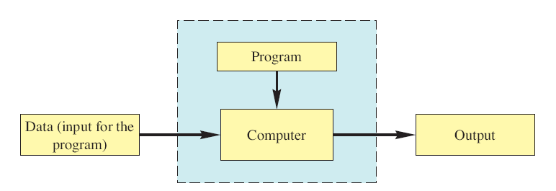
Running a Program
Figure 1.2
Sometimes the computer and the program are considered to be one unit.
Programmers typically find this view to be more convenient.

Slide 18
The Operating System
The operating system is a supervisory program that oversees the operation of the computer.
The operating system retrieves and starts program for you.
Well-known operating systems including: Microsoft Windows, Apple’s Mac OS, Linux, and UNIX.

Slide 19
Programming Languages
High-level languages are relatively easy to use
Java, C#, C++, Visual Basic, Python, Ruby.
Unfortunately, computer hardware does not understand high-level languages.
Therefore, a high-level language program must be translated into a low-level language.

Slide 20
Compilers
A compiler translates a program from a high-level language to a low-level language the computer can run.
You compile a program by running the compiler on the high-level-language version of the program called the source program.
Compilers produce machine- or assembly-language programs called object programs.

Slide 21
Compilers
Most high-level languages need a different compiler for each type of computer and for each operating system.
Most compilers are very large programs that are expensive to produce.

Slide 22
Java Byte-Code
The Java compiler does not translate a Java program into assembly language or machine language for a particular computer.
Instead, it translates a Java program into byte-code.
Byte-code is the machine language for a hypothetical computer (or interpreter) called the Java Virtual Machine.

Slide 23
Java Byte-Code
A byte-code program is easy to translate into machine language for any particular computer.
A program called an interpreter translates each byte-code instruction, executing the resulting machine-language instructions on the particular computer before translating the next byte-code instruction.
Most Java programs today are executed using a Just-In-Time or JIT compiler in which byte-code is compiled as needed and stored for later reuse without needing to be re-compiled.

Slide 24
Compiling, Interpreting, Running
Use the compiler to translate the Java program into byte-code (done using the javac command).
Use the Java virtual machine for your computer to translate each byte-code instruction into machine language and to run the resulting machine-language instructions (done using the java command).

Slide 25
Portability
After compiling a Java program into byte-code, that byte-code can be used on any computer with a byte-code interpreter and without a need to recompile.
Byte-code can be sent over the Internet and used anywhere in the world.
This makes Java suitable for Internet applications.

Slide 26
Class Loader
A Java program typically consists of several pieces called classes.
Each class may have a separate author and each is compiled (translated into byte-code) separately.
A class loader (called a linker in other programming languages) automatically connects the classes together.

Slide 27
Compiling and Running a Program
Figure 1.3

